Slide 1
Network Hardware

Slide 2
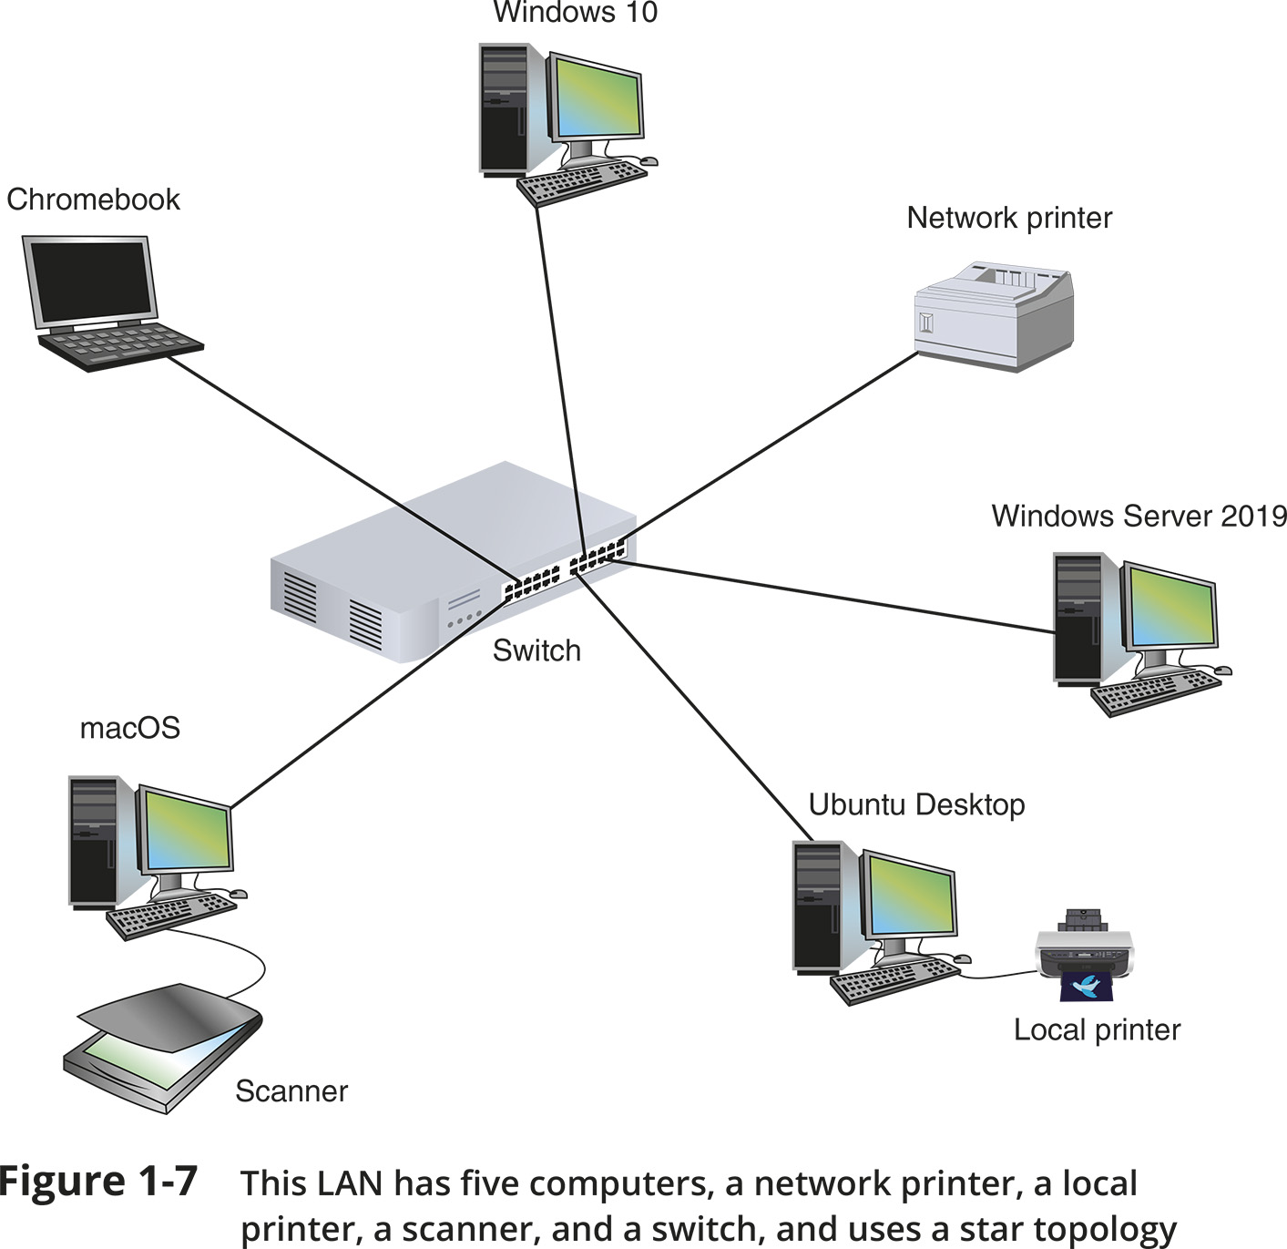
Network Hardware
Figure 1-7 This LAN has five computers, a network printer, a local printer, a scanner, and a switch, and uses a star topology

Slide 3
LANs and Their Hardware (1 of 4)
A LAN (local area network) is usually contained in a small space
A switch receives incoming data from one of its ports and redirects it to another port or multiple ports
Will send the data to its intended destination
The physical topology used by this network is called a star topology
All devices connect to one central device (usually a switch)
A NIC (network interface card) is a network port used to attach a device to a network
Also called a network adapter
A LAN can have several switches
A backbone is a central conduit that connects the segments (pieces) of a network

Slide 4
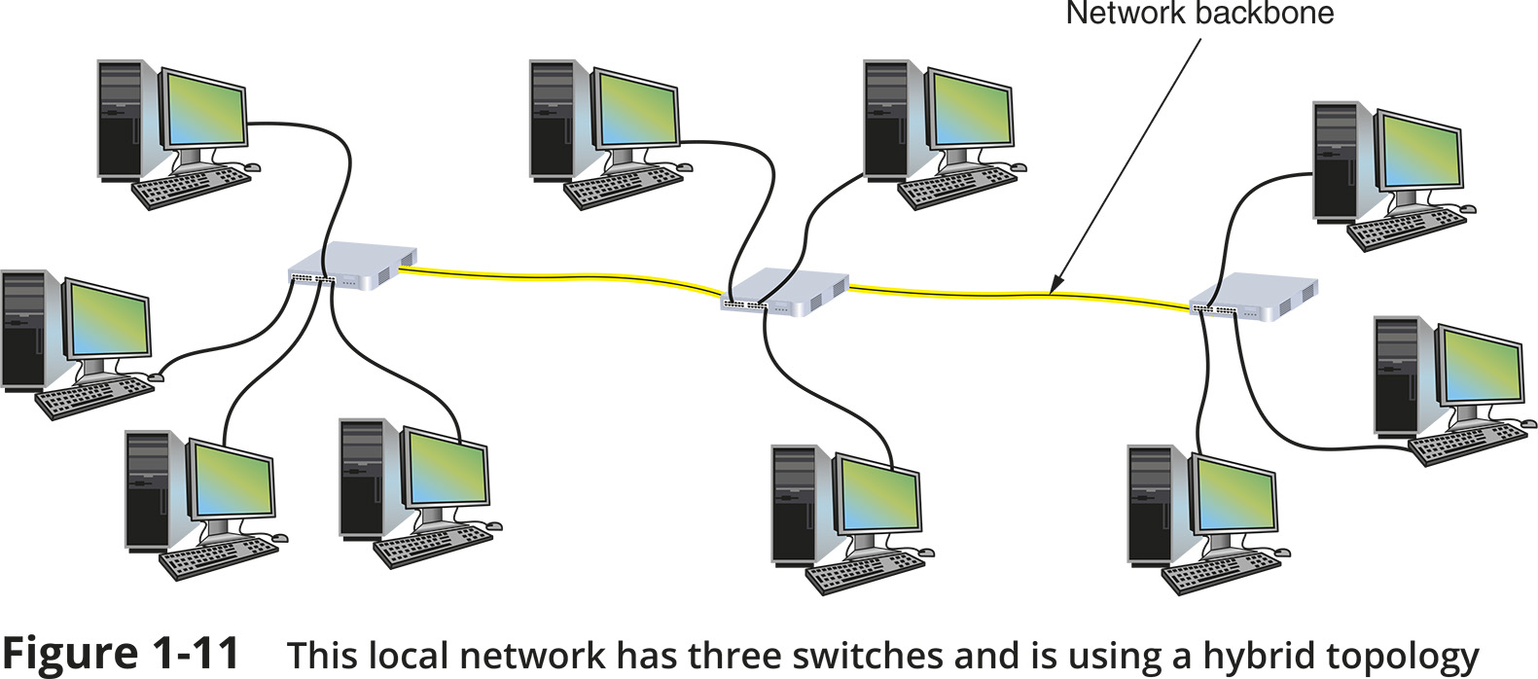
LANs and Their Hardware (2 of 4)
Figure 1-11 This local network has three switches and is using a hybrid topology

Slide 5
LANs and Their Hardware (3 of 4)
A router is a device that manages traffic between two or more networks
Can help find the best path for traffic to get from one network to another
Routers can be used in small home networks to connect the home LAN to the Internet
Called a SOHO (small office-home office) network
Industrial-grade routers can have several network ports, one for each network it connects to
Difference between router and switch:
A router is like a gateway between networks and belongs to two or more local networks
A switch belongs only to its local network

Slide 6
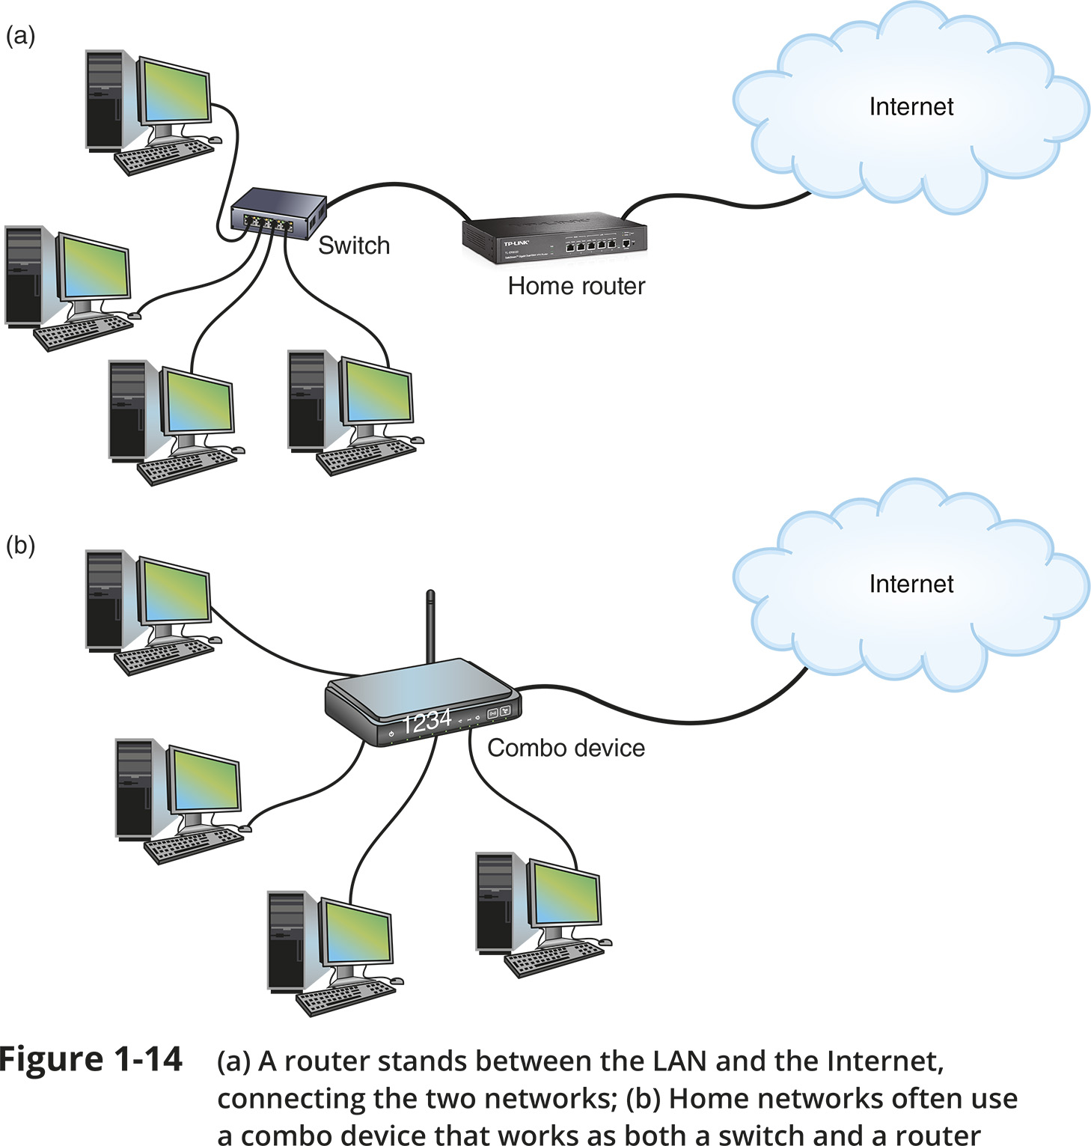
LANs and Their Hardware (4 of 4)
Figure 1-14 (a) A router stands between the LAN and the Internet, connecting the two networks; (b) Home networks often use a combo device that works as both a switch and a router

Slide 7
MANs and WANs (1 of 2)
A WAN (wide area network) is a group of LANs that spread over a wide geographical area
A MAN (metropolitan area network) is a group of connected LANs in the same geographical area
Also known as a campus area network (CAN)
MANs and WANs often use different transmission methods and media than LANs
PAN (personal area network) is a much smaller network of personal devices
A network of personal devices such as your smartphone and your computer
Other network types:
BAN (body area network)
SAN (storage area network)
WLAN (wireless local area network)

Slide 8
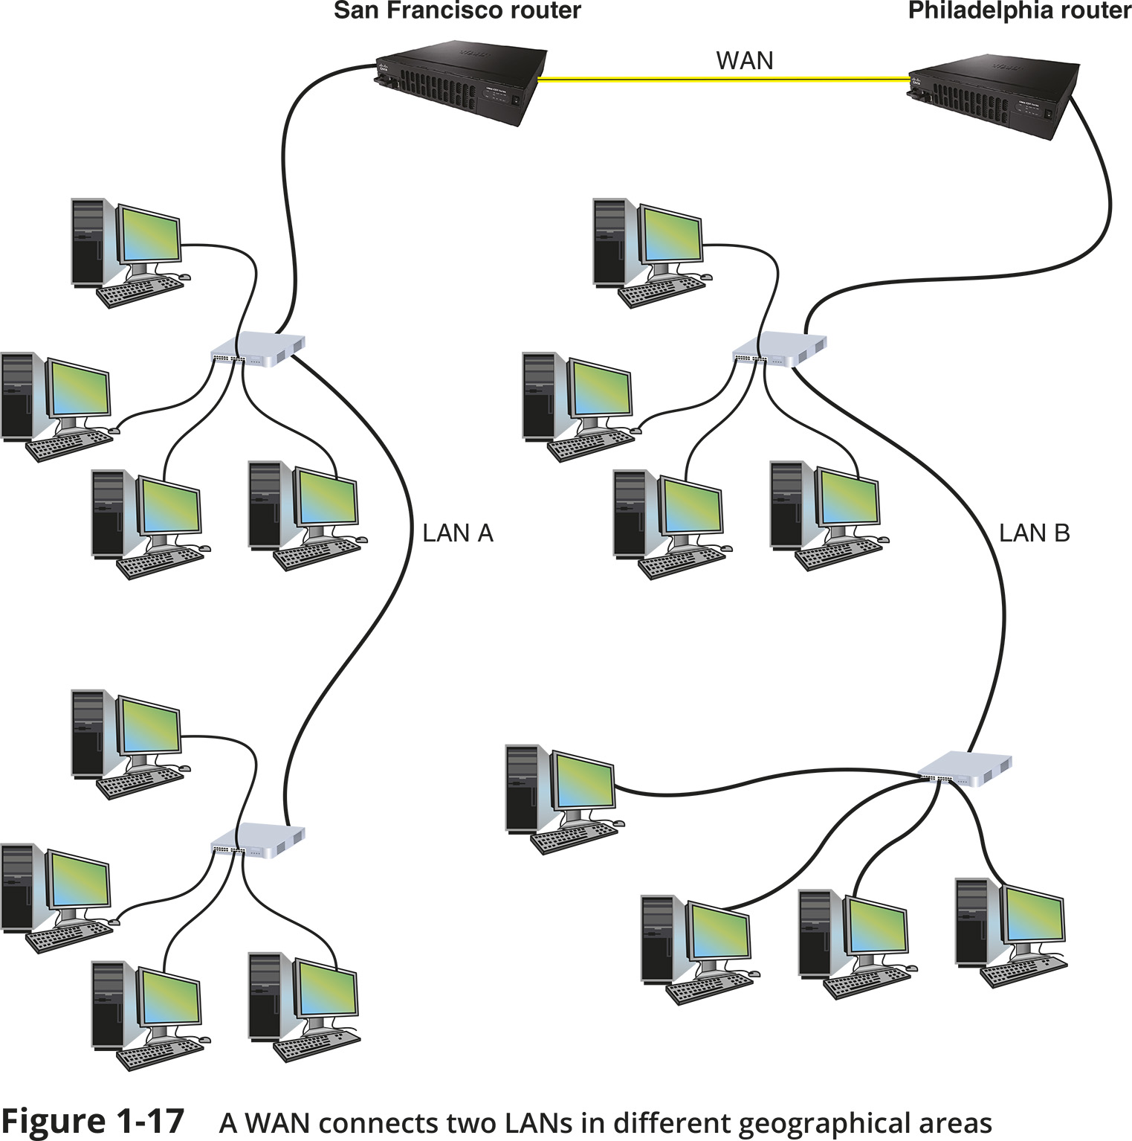
MANs and WANs (2 of 2)
Figure 1-17 A WAN connects two LANS in different geographical areas

